Slide 1
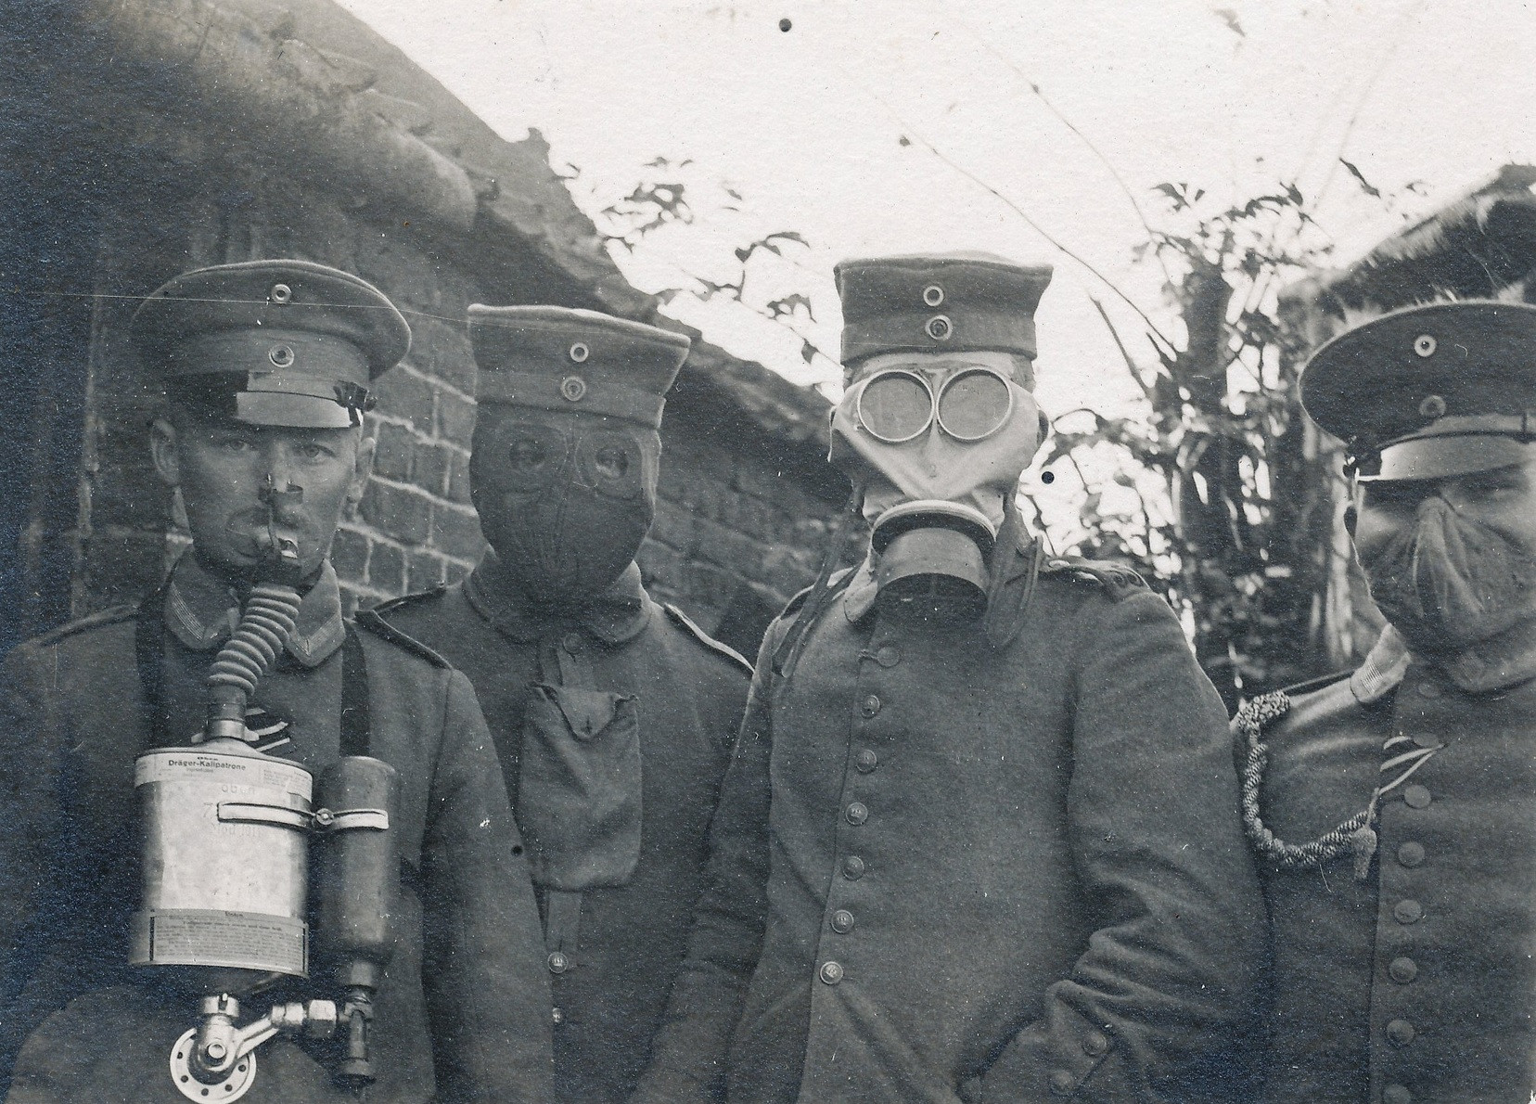
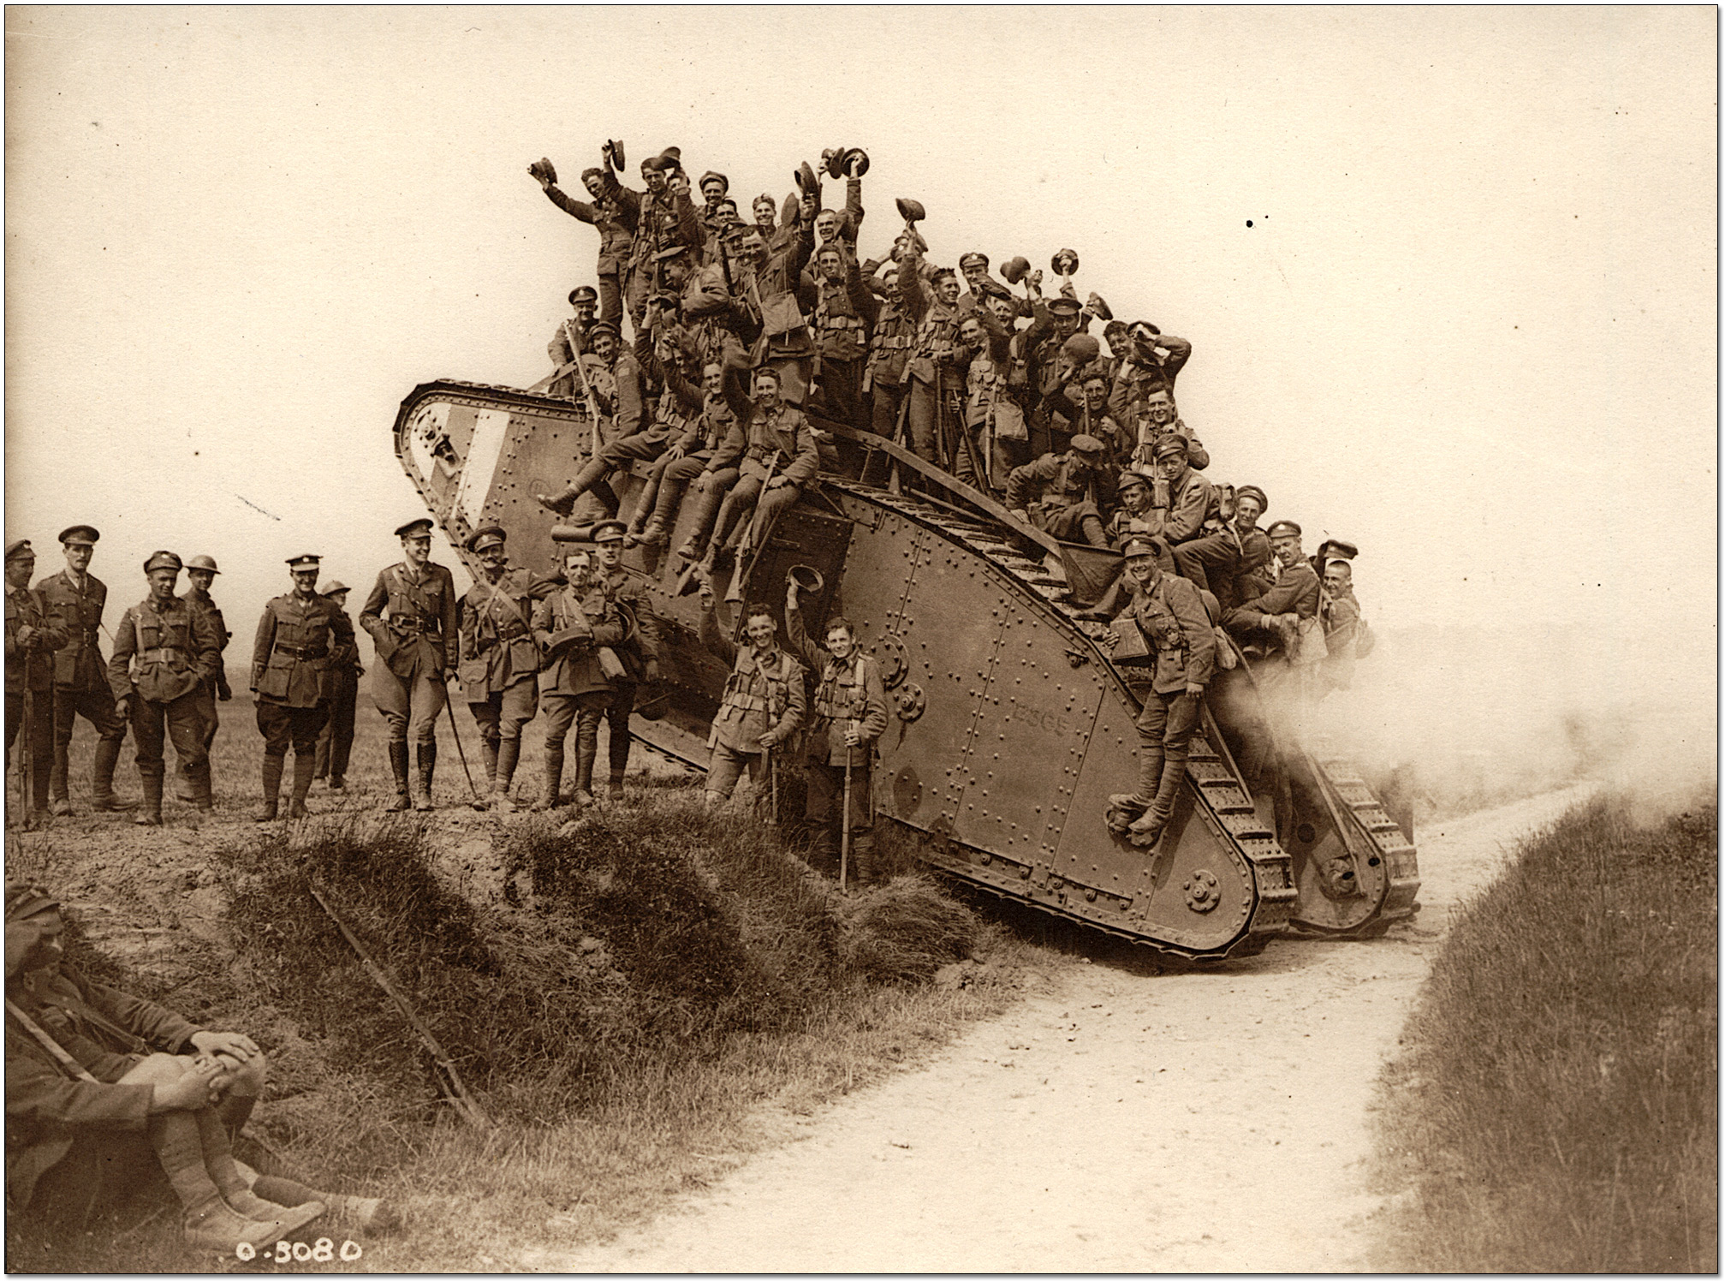
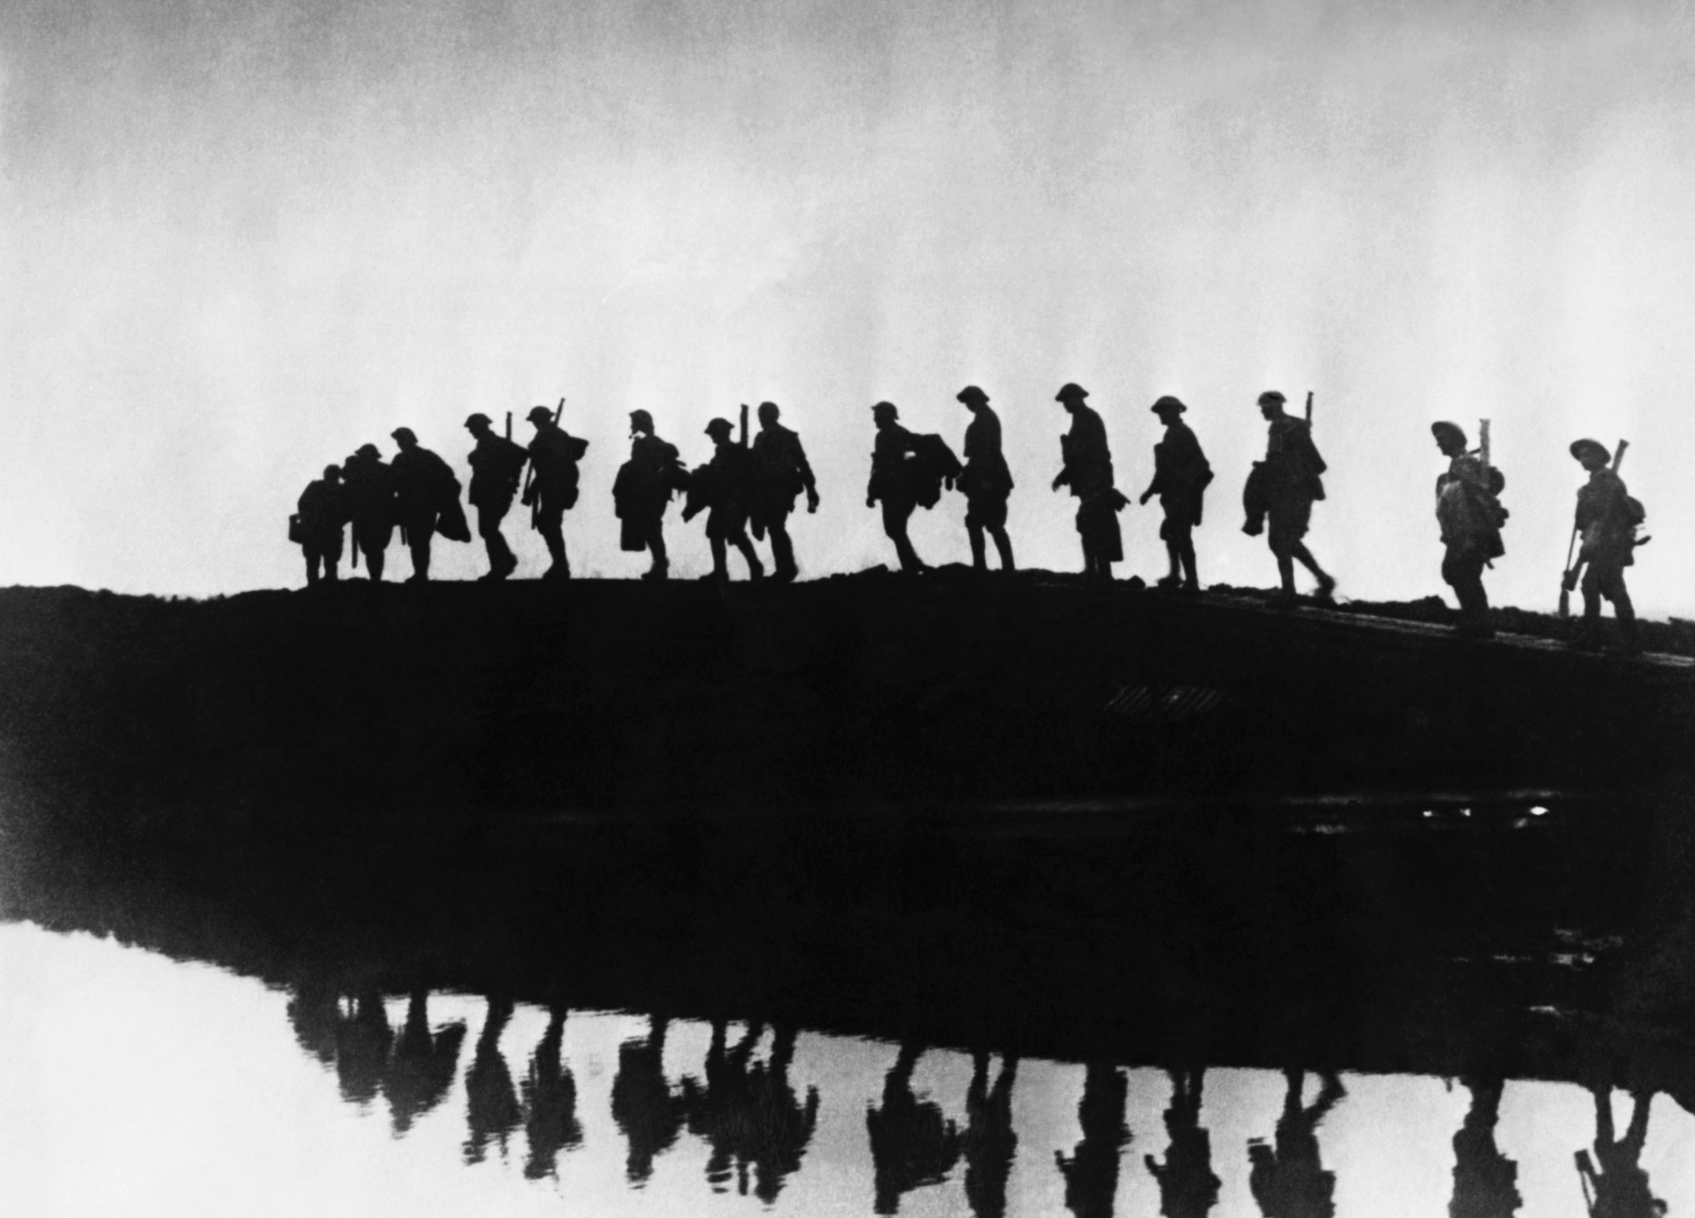
World War One

Slide 2
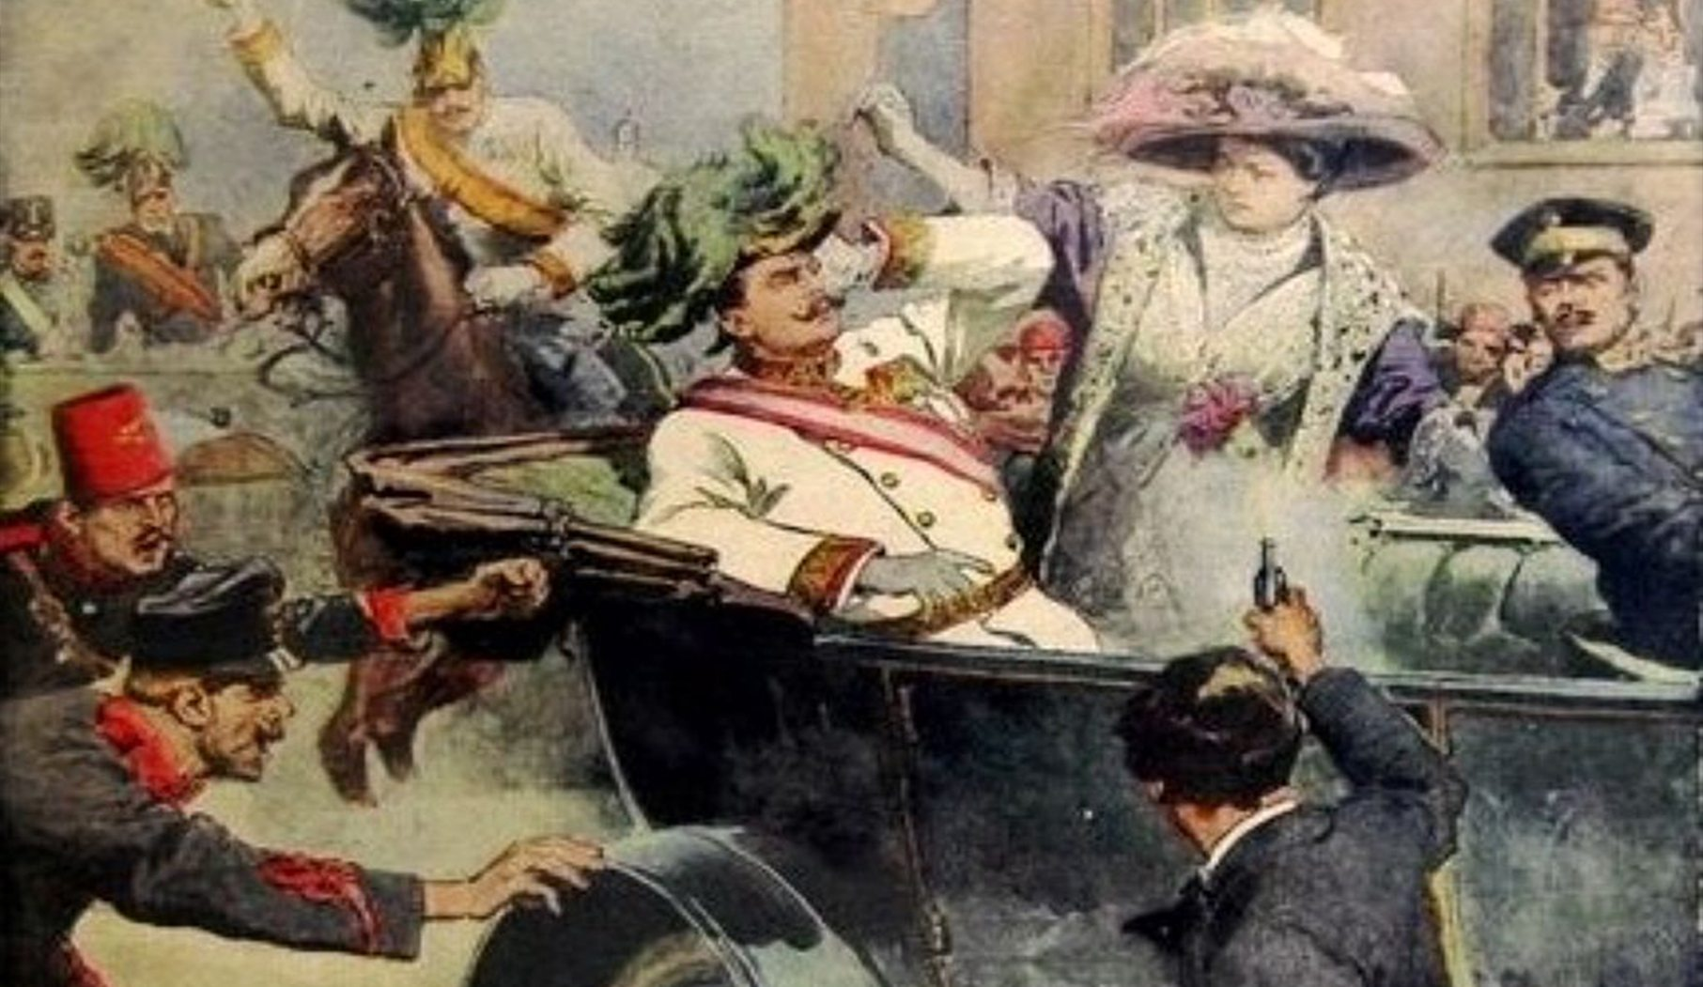

Slide 3
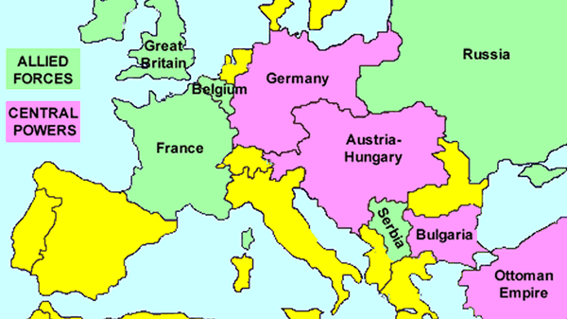

Slide 4
Imperialism and the Path to War
Increase of inter-imperialist conflicts
Surge in nationalism

Slide 5
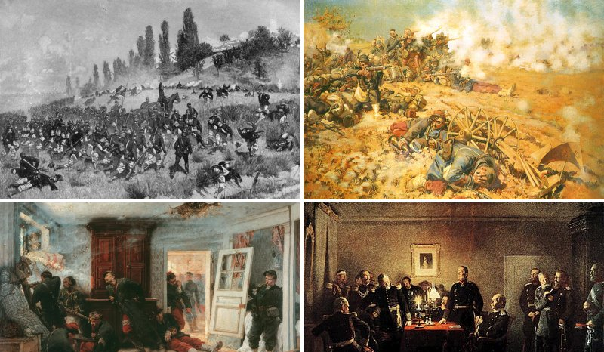
Franco Prussian War, 1870-1871
Stirred German nationalism and precipitated the unification of “little Germany” (minus Austrian Germans)
Germany secured resource-rich Alsace-Lorraine

Slide 6
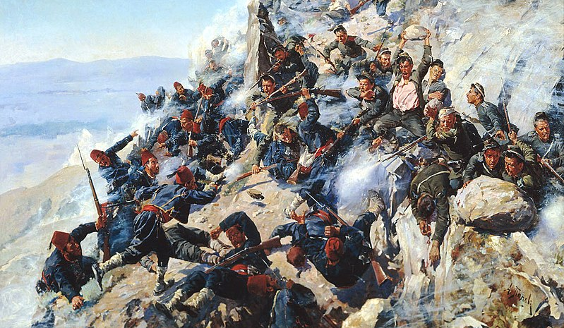
The Declining Ottoman Empire
Late-coming Russia saw Southeastern Europe (Balkans), and Western Asia as sites for territorial expansion
Russo-Turkish War (1877-1878) resulted in significant loss of territory
By end of nineteenth century imperialist powers knew about Western Asian oil

Slide 7
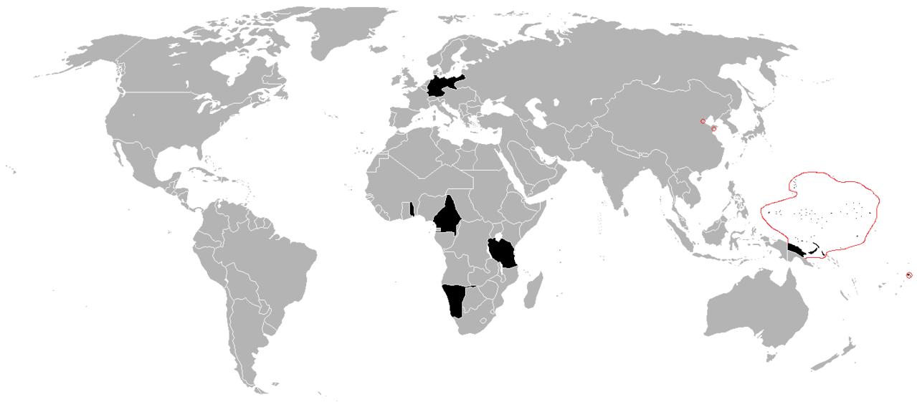

Germany’s Geographic Problem
Oil Discovery 1908
German Port Cities
Eastern Colonial Interests
Suez Canal
(British)
Basra (Ottoman Empire)

Slide 8
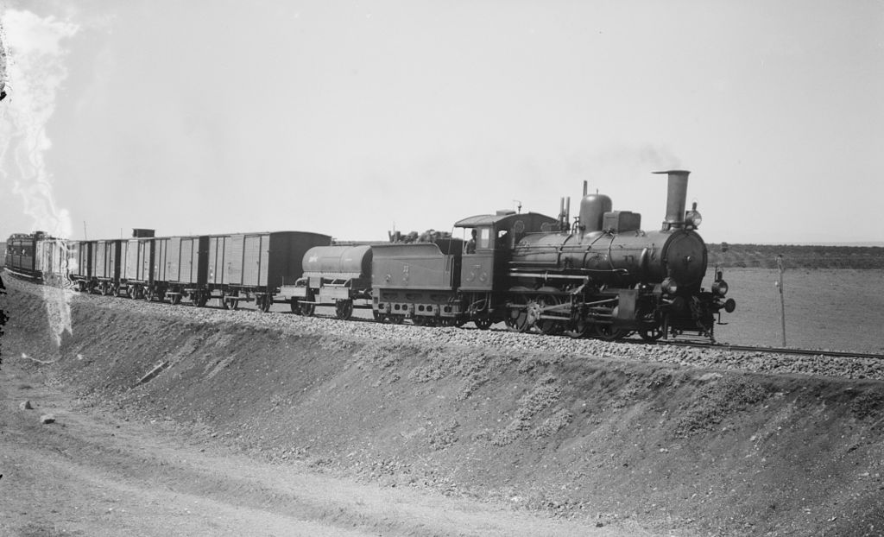
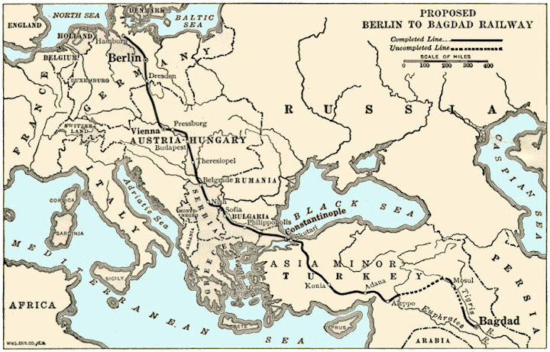
Berlin-Baghdad Railway
1903 Ottoman Empire granted concession to Baghdad Railway Company, under the control of German Deutsche Banks
Put shortest land route connecting Europe with richest British colony, India, in German hands. Germany would be able to siphon off portion of English profits by charging for shipping
Unified Turkey, against British and Russian imperial interests in the Balkans
Threatened Britain, Russia, France

Slide 9
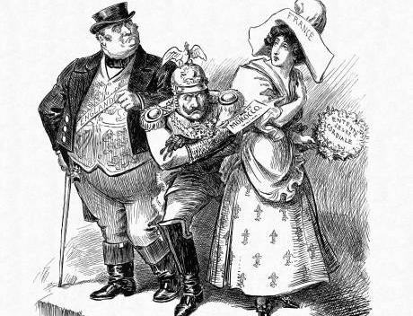
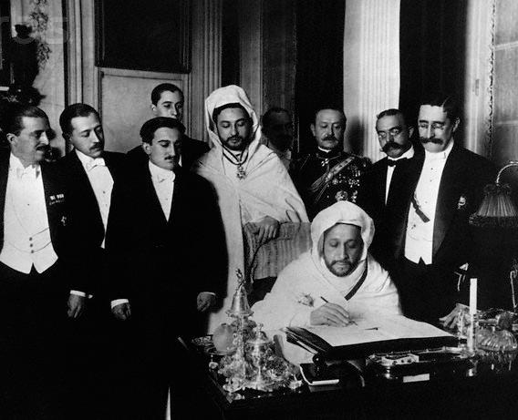
German-French Moroccan Crisis
Britain “gave” Morocco to France at the formation of Anglo-French Entente, 1904
Kaiser met with Sultan Abdelaziz to support bid for Moroccan independence
Inflamed British and French fury, threatening a German-French war
Longer term- pushed Britain and France together and spurred military buildup

Slide 10
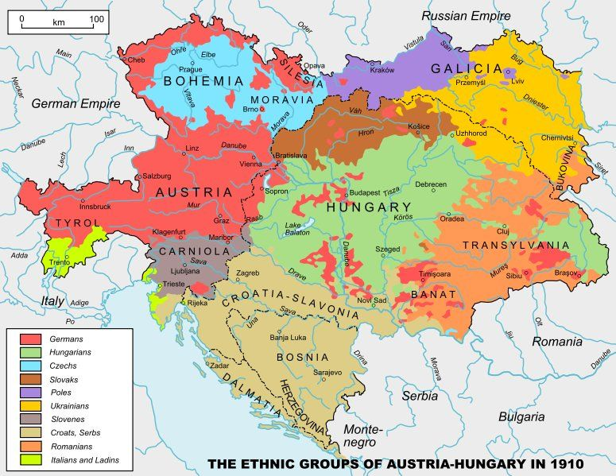
Germany’s Political Problem
Break-up of Austro-Hungarian Empire would crowd Germany on both sides
Absorbing Austrian Germans (Hapsburg) would undermine Prussian (Hohenzollern) dominance of Germany

Slide 11
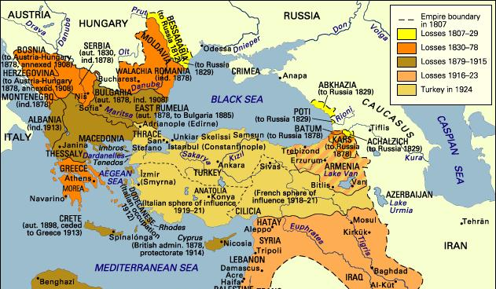
Turkish Revolution 1908
Destabilized delicate balance of power in the Balkans
Austria seized opportunity to annex Bosnia-Hercegovina
War between Russian and Austria only avoided when Germany declared military support for its ally

Slide 12
The Great War

Slide 13
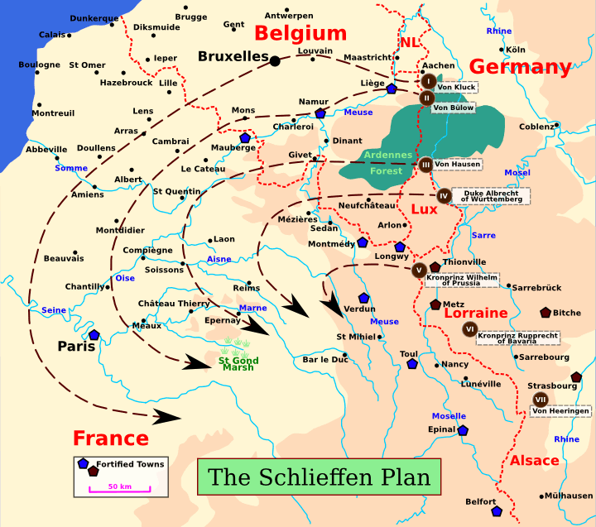
Schlieffen Plan

Slide 14
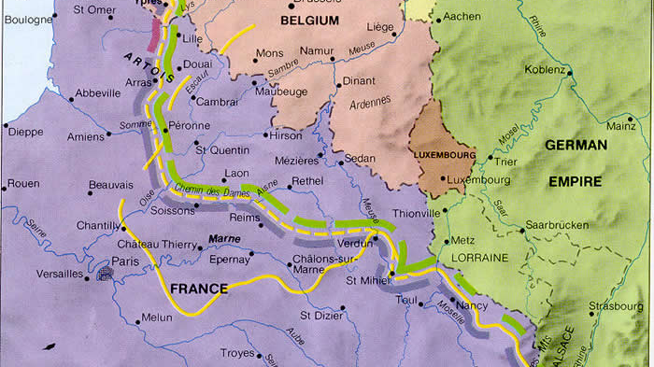

Slide 15
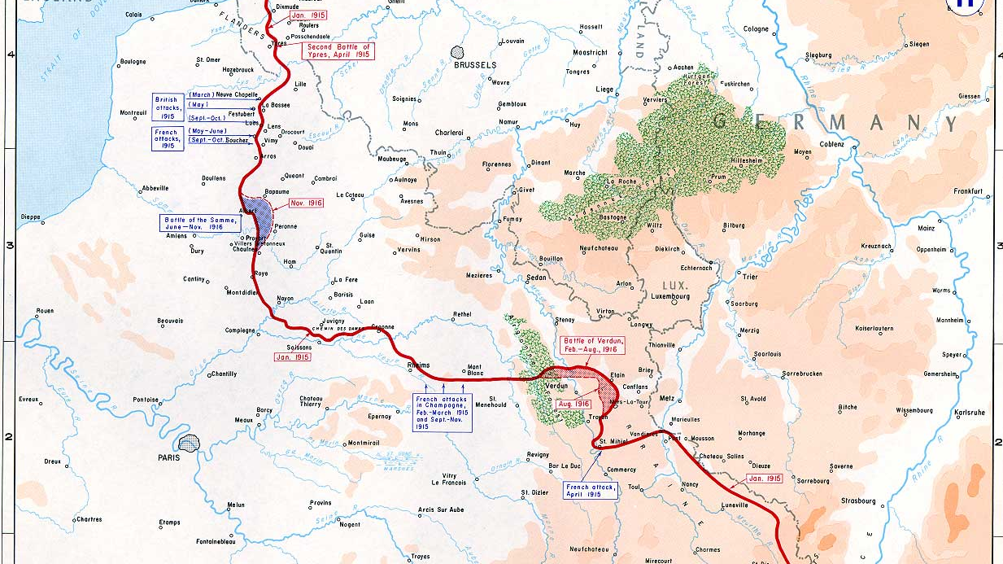

Slide 16
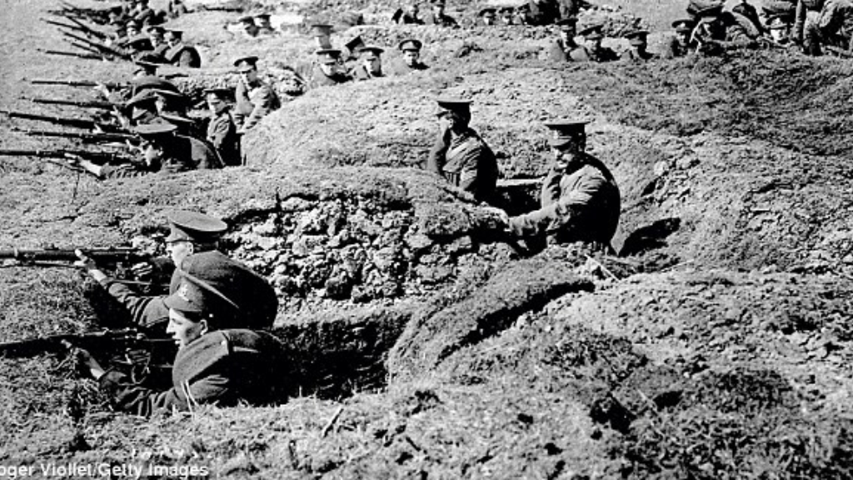

Slide 17
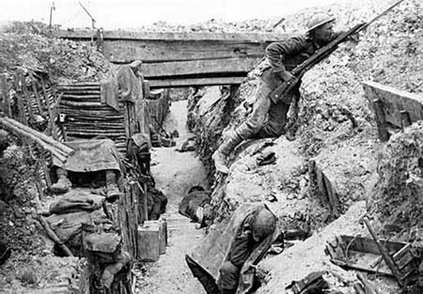

Slide 18
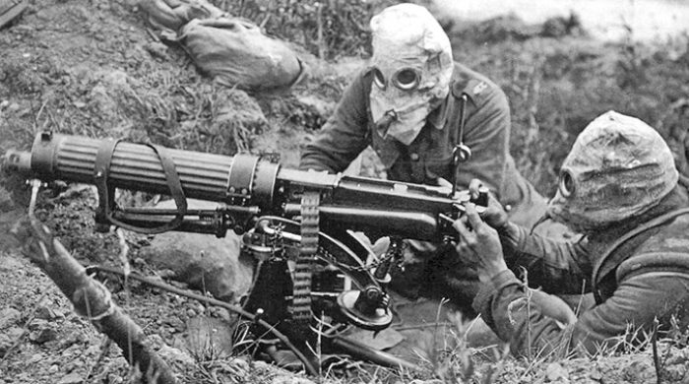
Why Trench Warfare?
Technological sweet spot
Relative balance of forces

Slide 19
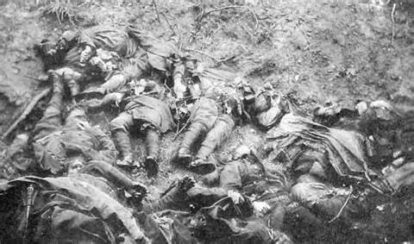
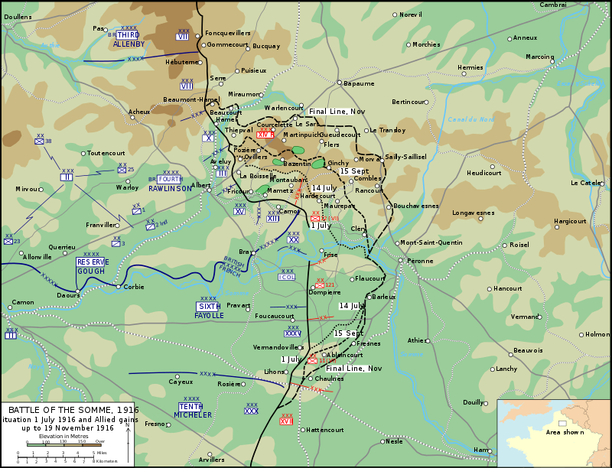
Battle of the Somme
Major British offensive in 1916, with months of preparation
Broke through German front line, but not much further
Ended in complete disaster for the Allies, barely nudging the line and resulting in hundreds of thousands dead

Slide 20
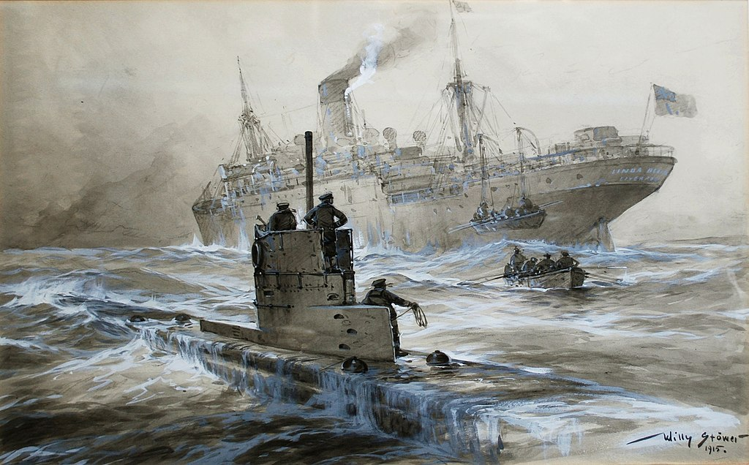
Naval Blockades
Germany and Britain vied for control of shipping lines, to starve each other out
German navy had a virtual monopoly on submarine technology

Slide 21
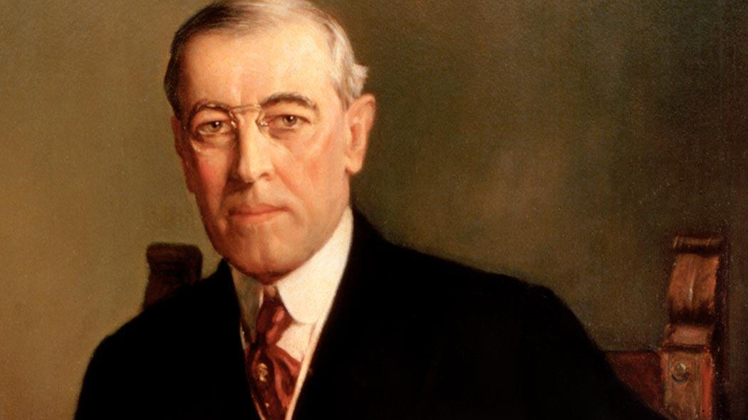
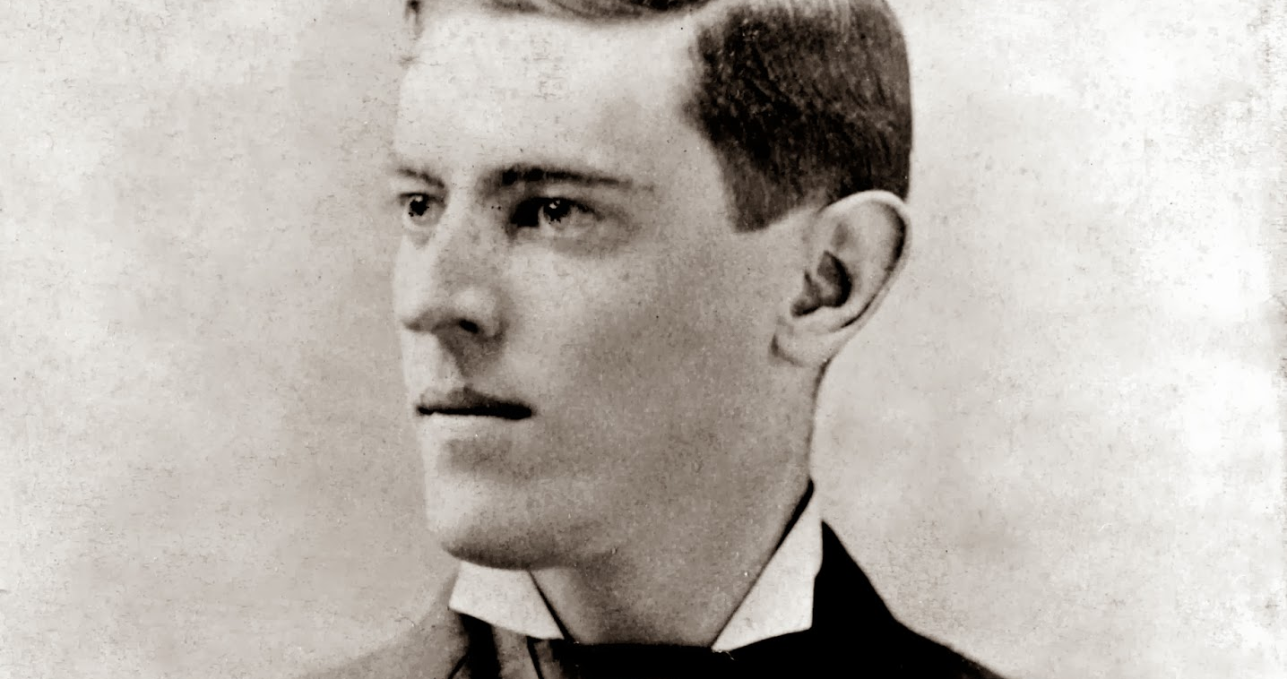
Woodrow Wilson
Scholar and experienced administrator, but little experience in or knowledge of foreign policy
Corporate Liberal, Reformer
Sympathetic to Allies, but inclined to stay neutral

Slide 22
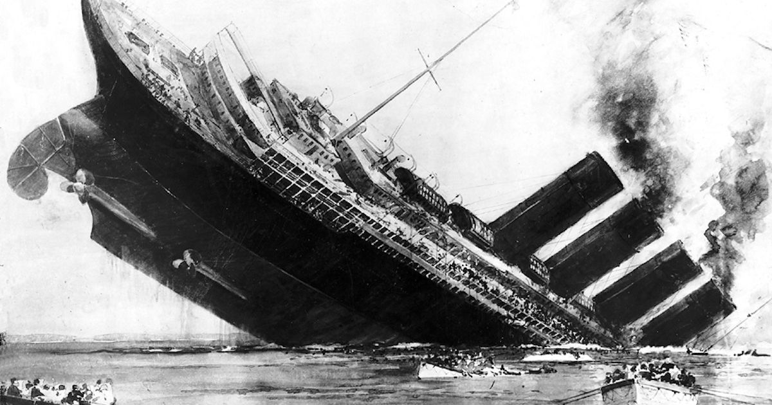

Slide 23
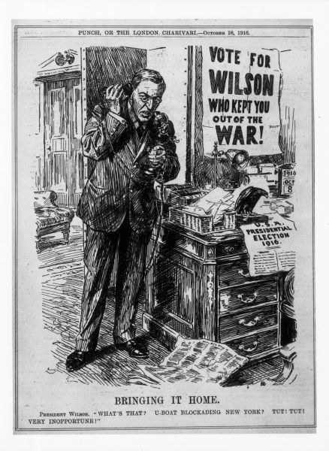
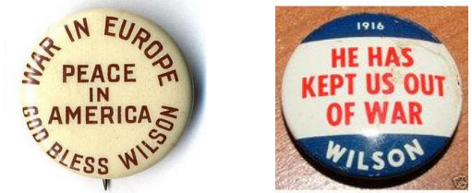
Woodrow Wilson Runs on Campaign Slogan: “He Kept US Out of War” in 1916

Slide 24
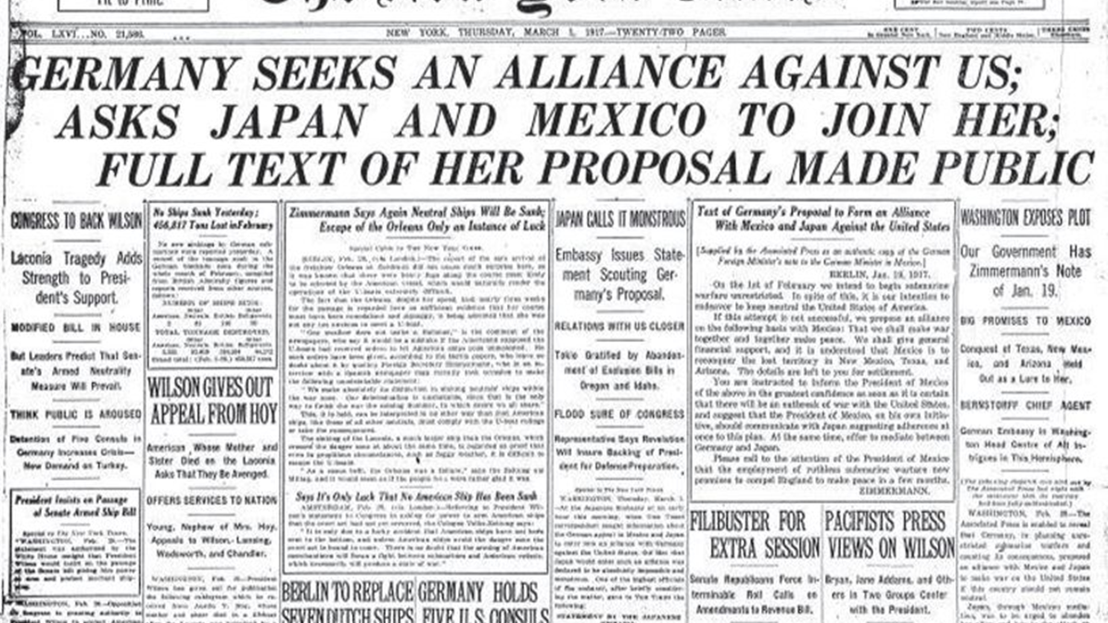
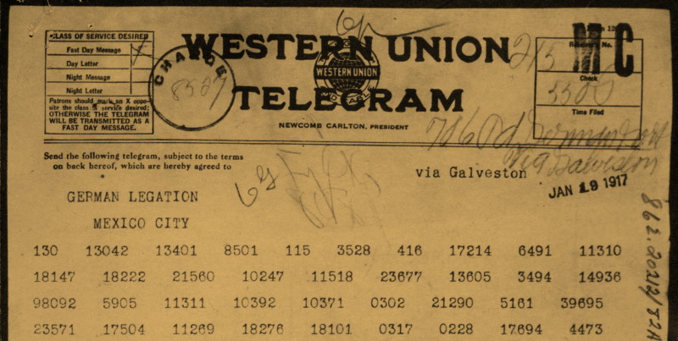
Zimmerman Telegram

Slide 25
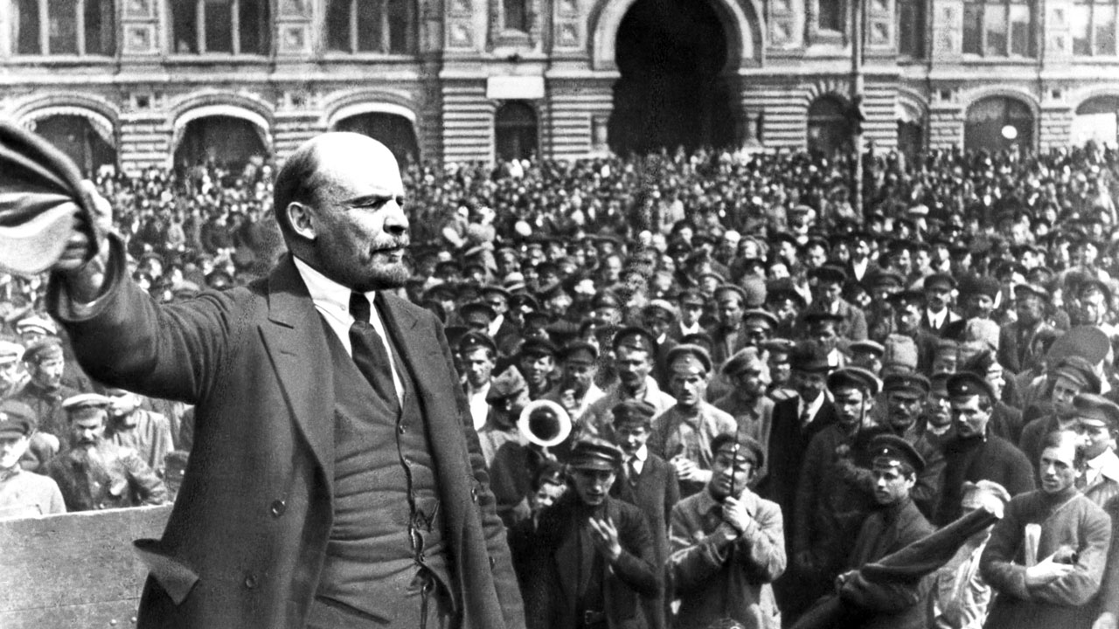

Slide 26
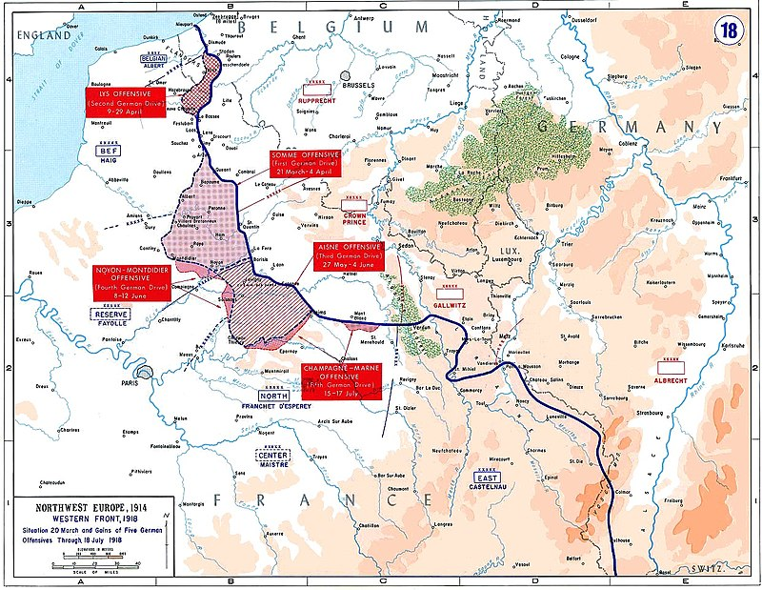

Slide 27
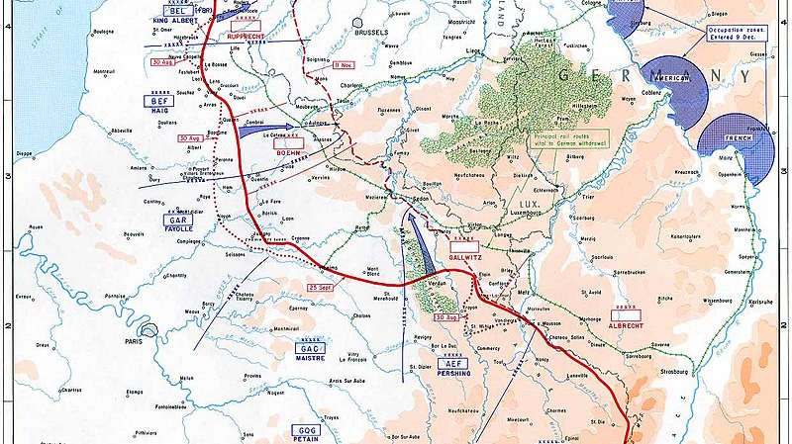

Slide 28

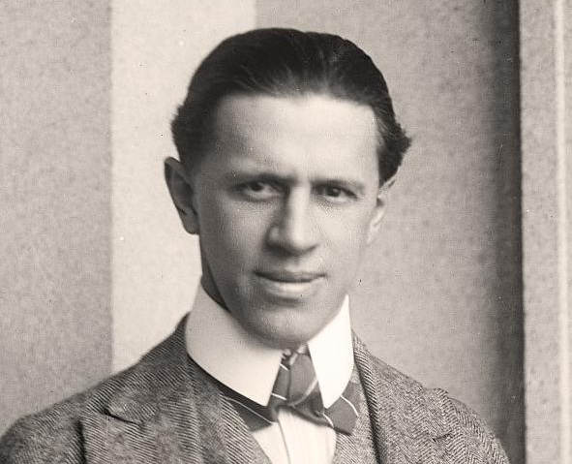
Modern Propaganda Agencies
US Committee on Public Information headed by George Creel employed state-of-the-art marketing techniques
US: 75 million pro-war pamphlets, posters, newspapers advertisements, and motion pictures
German Universum Film Aktiengesselschaft (UFA) mobilized German film-making in the service of German nationalism

Slide 29
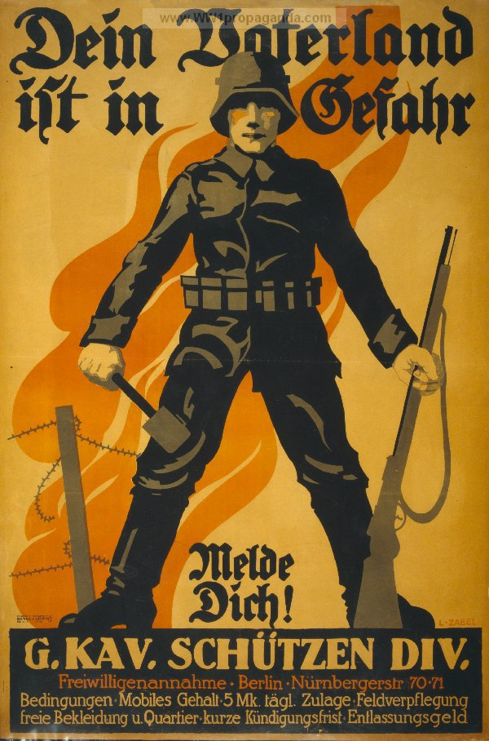
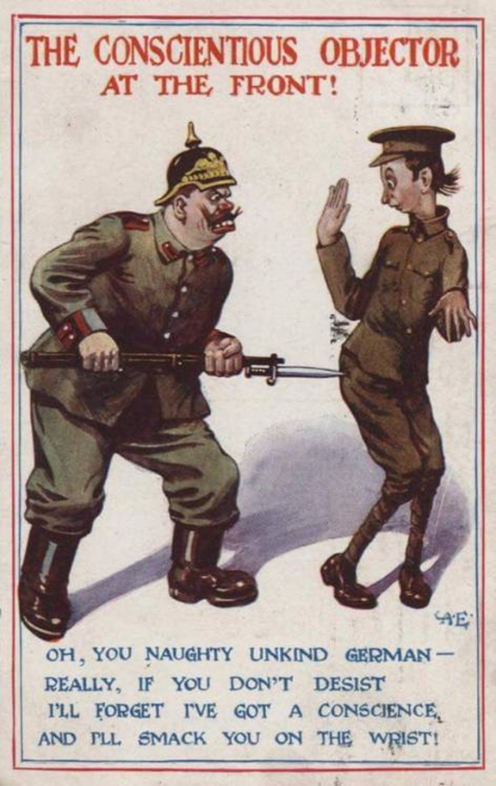
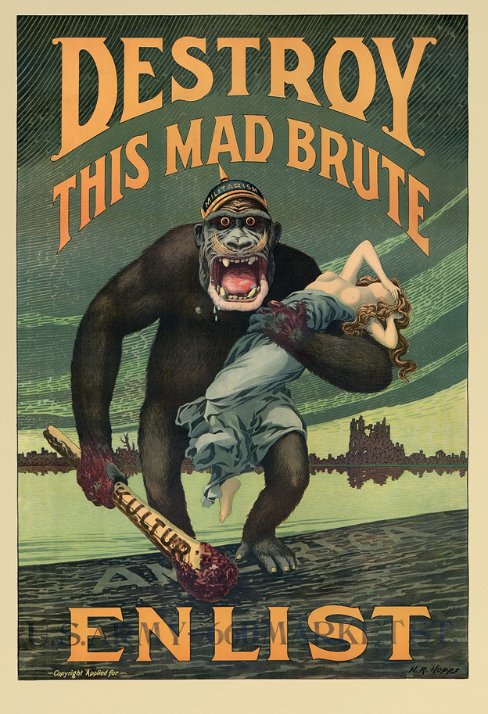

Slide 30
Consequences of World War I
Victors without peace
Self-determination and its limits
Disillusion

Slide 31
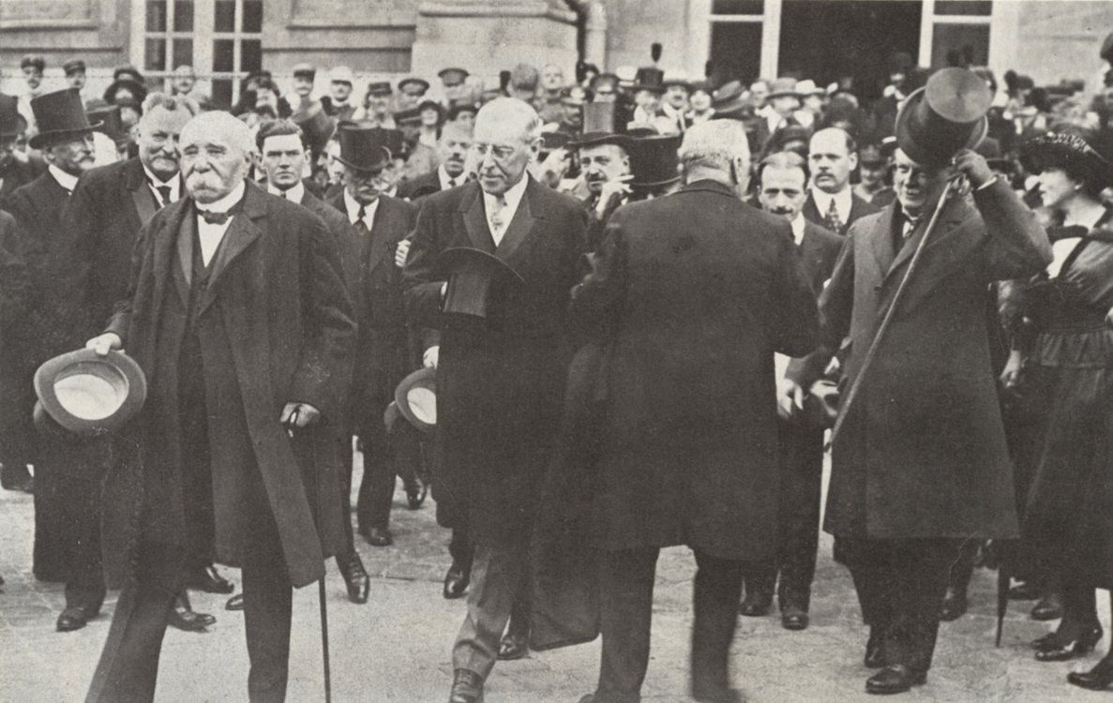
Treaty of Versailles
US dabbles with global hegemony
German guilt and war debt clauses

Slide 32
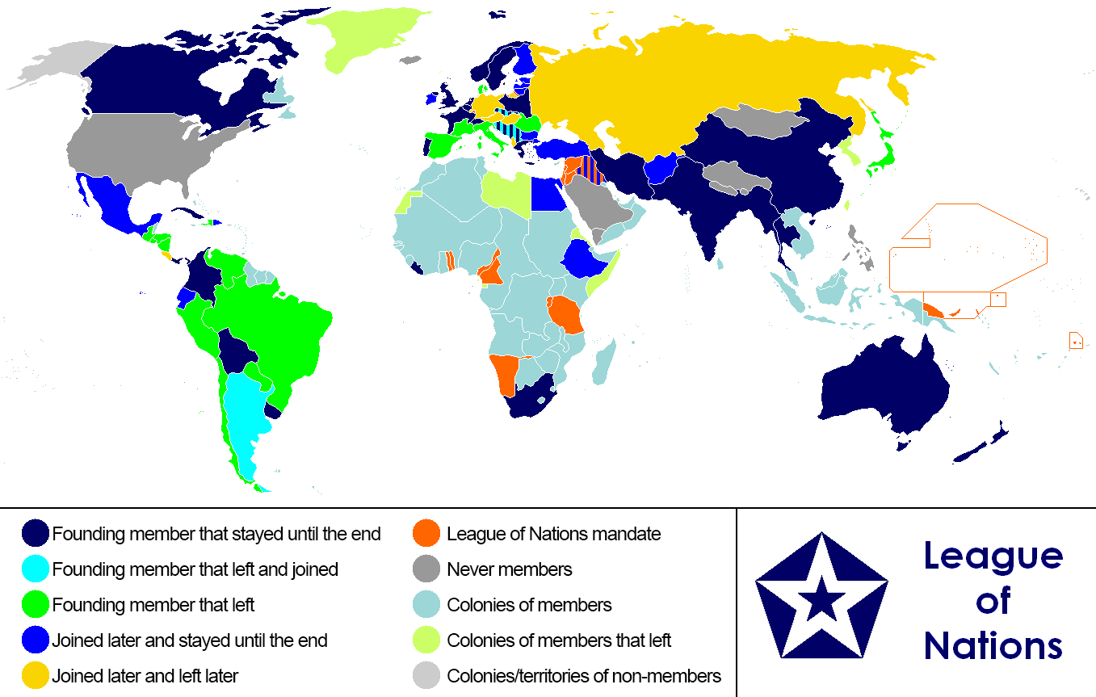
Wilsonian Liberal Internationalism
Fourteen Points included right of all nations to self-determination
League of Nations, precursor to United Nations
US Congress would not ratify entrance into League of Nations, Wilson’s brainchild

Slide 33
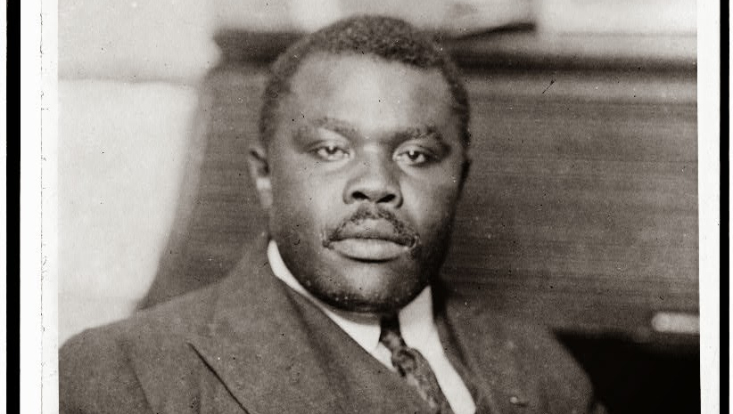
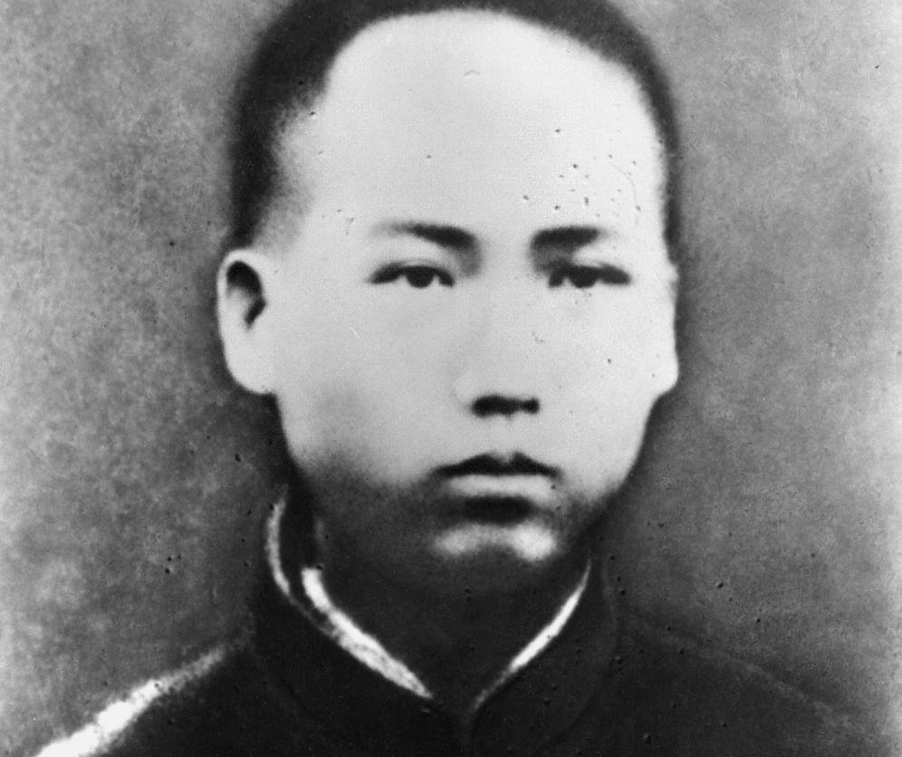
Contradictions of Liberal Internationalism
“Right” of self-determination frequently withheld
Marcus Garvey (top) began black nationalist movement in U.S. by appropriating Wilsonian rhetoric
Mao Zedong saw through the rhetoric and helped spur Communist Anti-Colonial movements

Slide 34
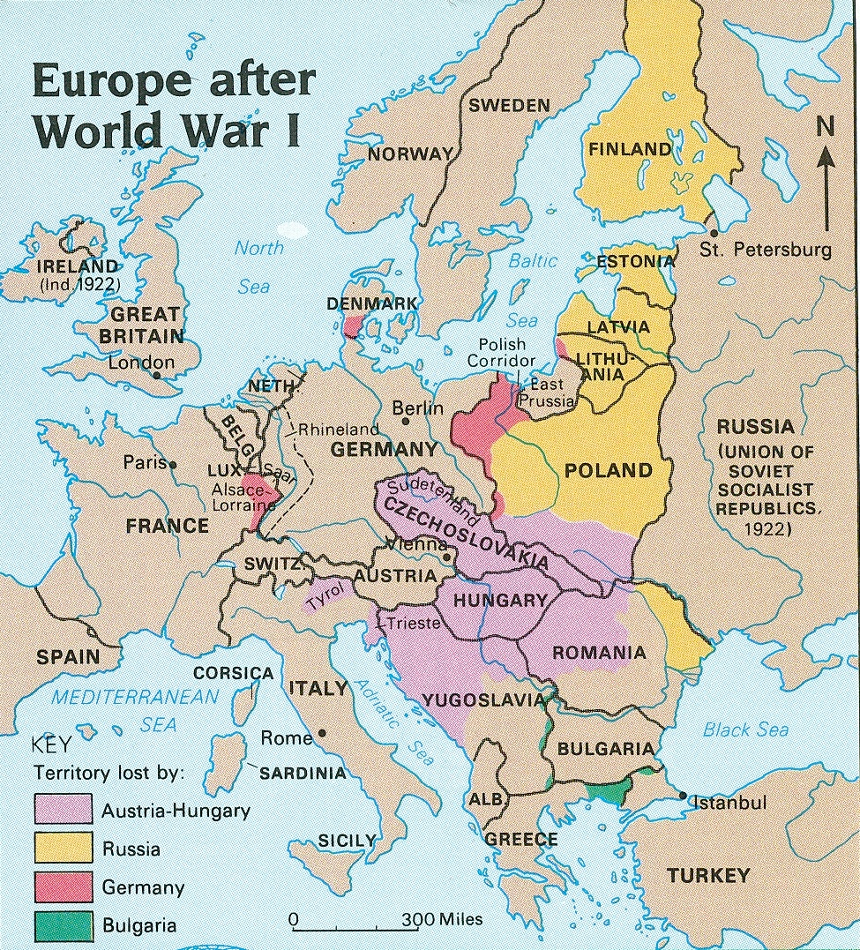

Slide 35
The War Debt and Reparations Cycle
Old debt paid by taking on new debt, clearly unsustainable without productivity growth
War guilt clause and reparations stymied German development, cutting off any path out of this cycle
U.S
Germany
Britain/France
War Debts
Loans
Reparations

Slide 36
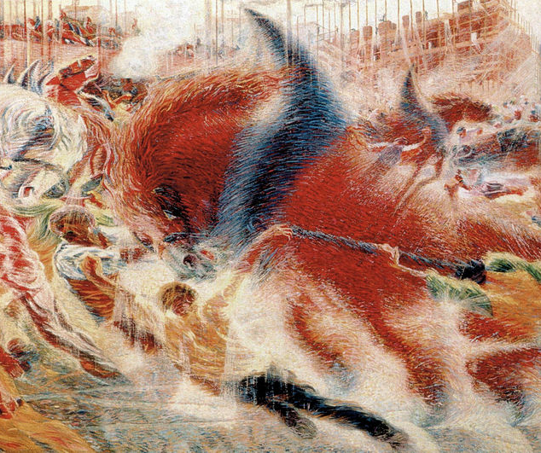
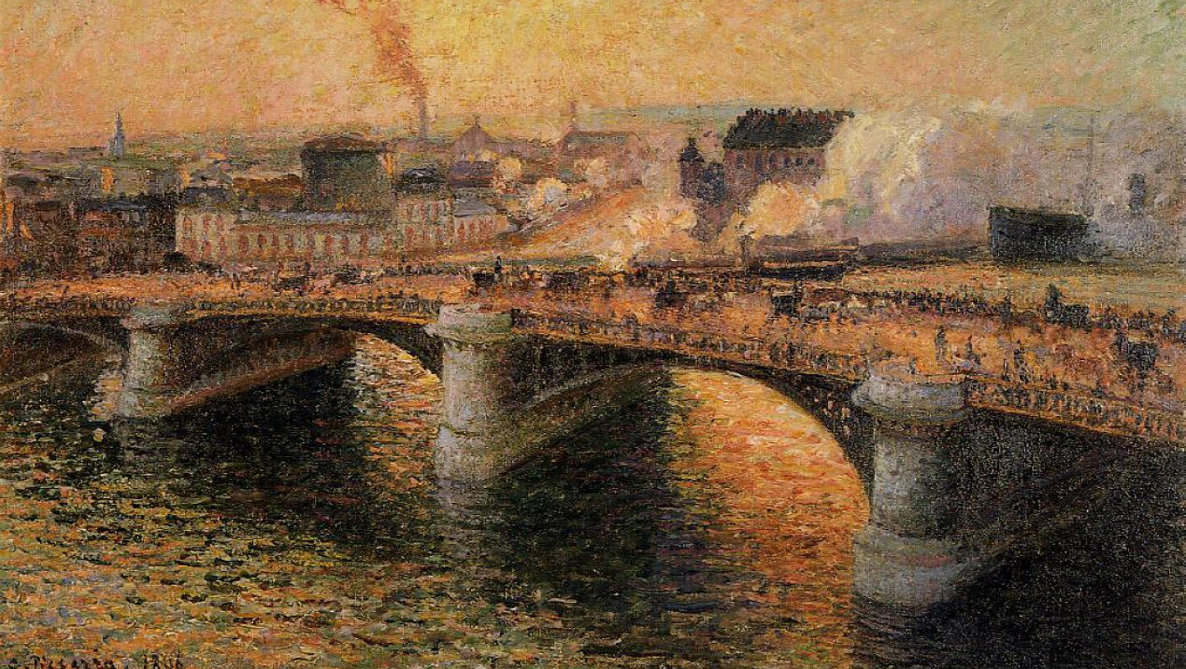
Pre-War Modernism

Slide 37
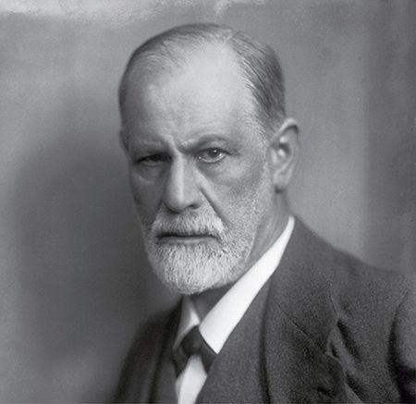
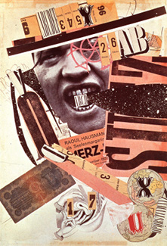
Subjectivity and Irrationality
Freudian psychology grew notably more pessimistic, focusing on irrationality of the unconscious mind, the death instinct, and the anxiety of civilization
Dada art movement built on modernist tampering with form, injected themes of nonsense, irrationality, and anti-capitalism

